Slide 1
Welcome
Thanks for joining!
The webinar will begin shortly.
*If you are viewing on a government computer, please disconnect from your agency’s network/VPN.*
If you cannot hear through your computer, please dial: 1-800-832-0736. Enter Room: 7563371#

Slide 2
Will Design for Six Sigma Work for Government Processes?
Presented by Megan Huss
Managing Director, Process & Performance Improvement Program
Center for Leadership Development
Developing Visionary Leaders to Transform Government
LEADERSHIP.OPM.GOV | CLDConnect@opm.gov
OPM HR SOLUTIONS
by government, for government
HR Solutions | 1900 E Street NW Washington, DC 20415 | www.opm.gov/HRS | 202-606-8001

Slide 3
Strategic Alignment
President’s Management Agenda
Key Driver of Transformation
People – Workforce for the 21st Century
Cross-Agency Priority Goal 6:
Shifting from Low-Value to High-Value Work
OPM Strategic Plan Initiative
Optimize Agency Performance

Slide 4
Who is Joining Us today?
Which of the statements most closely reflects your process improvement and development background?
I have led or participated in process improvement and development projects directly.
I have some knowledge of process improvement and development projects but no personal experience.
I have no knowledge or personal experience in this area but I’m looking forward to learning about it!

Slide 5
Agenda
How do we future-proof our skill set?
What is DFSS and how can we model it?
How does DFSS compare to LSS?
What are some critical DFSS concepts?
How can DFSS be used in my organization?

Slide 6
What Skills Are Needed in the Future?

Slide 7
Design for Six Sigma Models
Define
Measure
Analyze
Design
Verify

Slide 8
Process & Performance Improvement
PROCESS
Design for Six Sigma
(DFSS)
Lean Six Sigma
(LSS)
Process development
■
Proactive approach based on problem prevention
■
Predict, model, and simulate process delivery
Process improvement
■
Improvement approach based on existing process
■
Map, measure, analyze, improve & control process

Slide 9
Organizational Transformation Through Process Design & Improvement
Emphasize efficiency and effectiveness to create a more lean, accountable public sector
Maximize use of resources by shifting from low-value to high-value work
Design and improve functions that are administratively burdensome, redundant, or pain points for the individual or organization
Uncover root causes and use data to drive decisions and solutions at all levels in the organization
Allow and support employees’ ability to focus on more engaging and intellectually challenging work

Slide 10
Why Design New Processes?
Interpretation of customer needs – uncertain, incorrect, or incomplete
Limited alternatives analyzed and assessed
Limited requirements available
No clear stopping point
New initiatives implemented or executed incorrectly

Slide 11
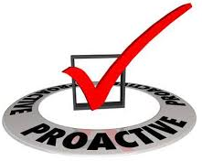
Using Design for Six Sigma to Be Proactive!
Provides structure for managing development projects
Prevents errors resulting in increased customer satisfaction
Improves communications among organizations
Ability to make predictions prior to full- scale implementation
Reduces total costs in the lifecycle
Focuses on all customers

Slide 12
Which Areas Would Benefit From Design for Six Sigma Improvements?
Some examples are listed below:
Human Resources
Contracting & Procurement
IT & Helpdesk
Approvals & Governance
What other ideas do you have?

Slide 13
Prioritizing Process Design & Improvement Themes
Heading
Heading
Heading
Idea
Idea
Idea
Idea
Idea
Idea
Idea
Idea
Idea
Idea
Idea
Idea
Idea
Idea
Idea
Idea
Idea
Idea
Idea
Idea

Slide 14
Saving Valuable Time: Federal Help Desk
Incoming Calls
Type 1 Assistance
Type 2 Assistance
NO Tier II Support Needed
Automated reply
Tier II Support Needed

Slide 15
Summary
How do we future proof our skill set?
What is DFSS and how can we model it?
How does DFSS compare to LSS?
What are some critical DFSS concepts?
How can DFSS be used in my organization?

Slide 16
Questions?

Slide 17
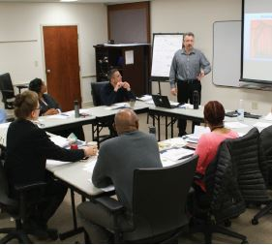
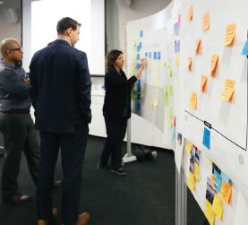
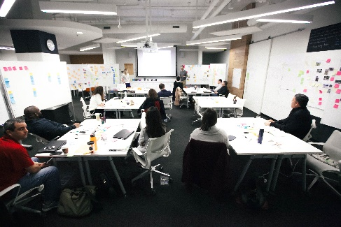
OPM HR Solutions Products Overview
OPM HR Solutions
Center for Leadership Development
Open enrollment courses & certificate programs for leadership and professional development | Virtual learning ecosystems to support the human capital lifecycle throughout government | Development programs focused on building decision-making skills through human-centered design and process improvement | Fellowship programs to recruit and develop leadership skills for highly-qualified talent for Federal agencies | Certification programs built specifically for government skills for various professions, such as the Federal HR Institute | Customized development program solutions to meet agency-specific needs
>> LEADERSHIP.OPM.GOV >> CLDConnect@OPM.gov

Slide 18
Contact Information
Thank you for your participation & service to our nation!
Process & Performance Improvement Program
Megan Huss, Managing Director
LeanSixSigma@opm.gov
Online-Only Lean Six Sigma Green Belt Training & Certification Programs: go.usa.gov/xEGh3
Center for Leadership Development
Developing Visionary Leaders to Transform Government
LEADERSHIP.OPM.GOV | CLDConnect@opm.gov
OPM HR SOLUTIONS
by government, for government
HR Solutions | 1900 E Street NW Washington, DC 20415 | www.opm.gov/HRS | 202-606-8001

